Slide 1

Predicting Problematic Internet Use
Aaron Weinberg
Emilie Wiesner
Dan Visscher
Notes:
The goal of our project is to predict cases of problematic internet use in children. [click]

Slide 2
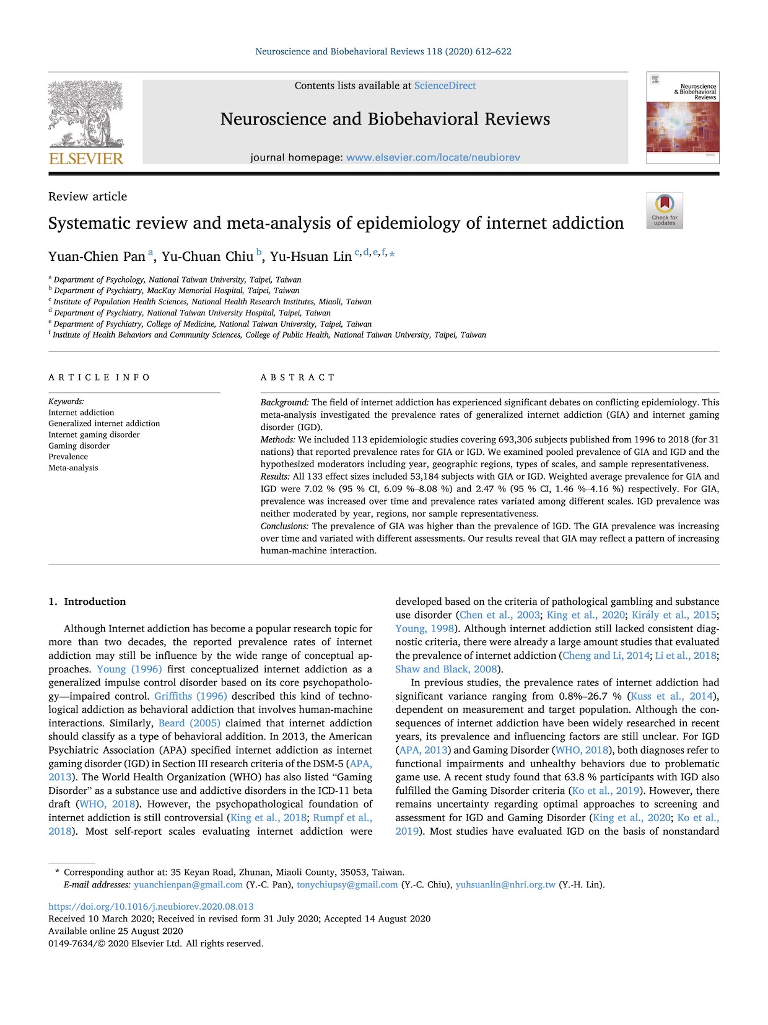



The Problem
Notes:
Internet use [click]
has been identified by researchers as having the potential to rise to the level of addiction, with [click]
increased rates of anxiety and depression associated with problematic internet use.
However, identifying problematic internet usage currently requires complex, expert evaluation, which limits our ability to identify it [click]
[click]

Slide 3




The Goal
Identify early signs of problematic internet use based on physical activity and fitness data.
Notes:
In contrast, It is relatively straightforward to [click]
administer simple surveys and [click]
measure children’s activity level. Thus, the goal of our project is to [click]
identify early signs of problematic internet use based on physical activity and fitness data. This particular research question [click]
was posed by the Child-Mind Institute, which supports children and families who are struggling with mental health [click]

Slide 4

5,000 children
Ages 5 through 22
No participants with complete data
HEALTHY BRAIN NETWORK
The Data
Notes:
The data comes from the Institute’s Healthy Brain Network study. [click]
About five-thousand 5-22 year-olds participated in the study, though we only received data for approximately four thousand of these participants, [click]
all of which was incomplete. [click]

Slide 5

Parent-Child Internet Addiction Test (PCIAT)
0
1
2
3
None
Severe
Severity Impairment Index (SII)
~3000 with at least some target information
Impute missing PCIAT scores
The Data: Target Variable
Notes:
The target variable is [click]
the severity impairment index, or sii. Participants completed [click]
A 20-question parent-child internet addiction test, or PCIAT. [click]
The total scores were binned into four levels, [click]
ranging from 0, or no impairment, to 3, or severe impairment. [click]
Of the 3960 participants for whom we had some data only about 3,000 had at least some PCIAT data, [click]
We used KNN imputation to fill in missing PCIAT scores [click]

Slide 6


Demographics
Age
Sex
Physical
Height
Weight
BMI
Waist
Systolic BP
Diastolic BP
Heart Rate
The Data: Predictor Variables
Notes:
We were given a total of 33 predictor variable. The variables naturally fall into several groupings. [click]
Basic demographics [click]
Such as age and sex [click]
And basic physical measurements like height and weight. [click]

Slide 7

Demographics
Age
Sex
Internet Use
Hours per Day
Physical
Height
Weight
BMI
Waist
Systolic BP
Diastolic BP
Heart Rate
Children's Global Assessment Scale
Sleep Disturbance Scale
Physical Activity Questionnaire
PAQ MVPA Zone
The Data: Predictor Variables
Notes:
Then there was data from several surveys [click]
Including reported internet use [click]
A Children’s Global Assessment Scale [click]
A Sleep Disturbance Scale [click]
And a physical activity questionnaire. [click]
A review of the research suggested cutoffs we used to compute whether participants had reached a physical activity threshold. [click]

Slide 8
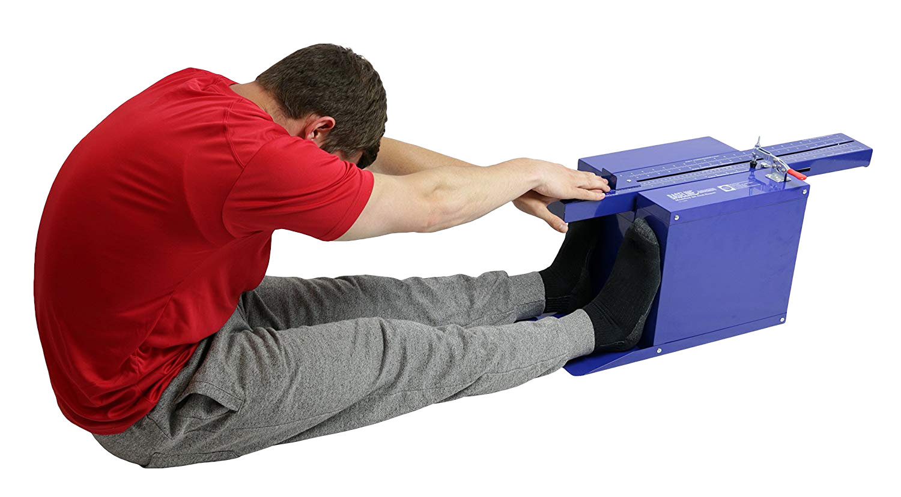

Demographics
Age
Sex
Internet Use
Hours per Day
Fitness
Endurance Time
Endurance Max
Curl-Up
Grip Strength D
Grip Strength ND
Push-Up
Sit & Reach Left
Sit & Reach Right
Trunk Lift
Physical
Height
Weight
BMI
Waist
Systolic BP
Diastolic BP
Heart Rate
Children's Global Assessment Scale
Sleep Disturbance Scale
Physical Activity Questionnaire
Fitness Zone
Curl-Up
Grip Strength D
Grip Strength ND
Push-Up
Sit & Reach Left
Sit & Reach Right
Trunk Lift
PAQ MVPA Zone
The Data: Predictor Variables
Notes:
There were also results from [click] a fitness test, and we found reference values to determine when these measurements was in a target zone. [click]

Slide 9
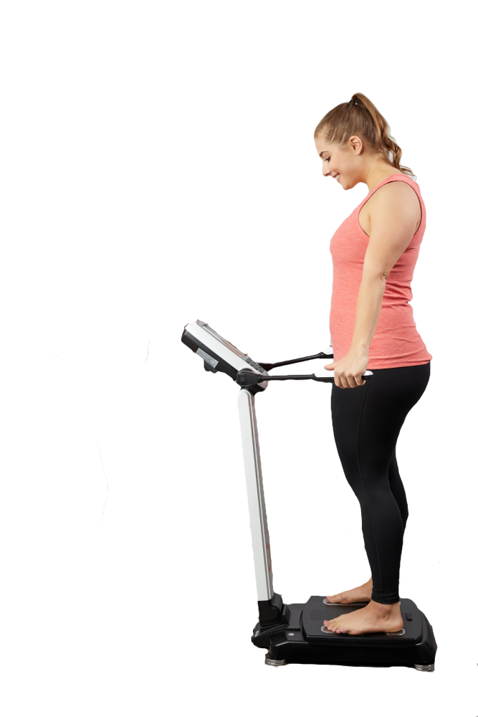

Demographics
Age
Sex
Internet Use
Hours per Day
Fitness
Endurance Time
Endurance Max
Curl-Up
Grip Strength D
Grip Strength ND
Push-Up
Sit & Reach Left
Sit & Reach Right
Trunk Lift
BIA
Bone Mineral Content
BMI
Basal Metabolic Rate
Daily Energy Exp.
Extracellular Water
Fat Free Mass
FFM Index
Fat Mass Index
Body Fat Percentage
Body Frame
Intracellular Water
Lean Dry Mass
Lean Soft Tissue
Skeletal Muscle Mass
Total Body Water
Physical
Height
Weight
BMI
Waist
Systolic BP
Diastolic BP
Heart Rate
Children's Global Assessment Scale
Sleep Disturbance Scale
Physical Activity Questionnaire
Fitness Zone
Curl-Up
Grip Strength D
Grip Strength ND
Push-Up
Sit & Reach Left
Sit & Reach Right
Trunk Lift
PAQ MVPA Zone
The Data: Predictor Variables
Notes:
Other predictors came from measurements of bio-electric impedance [click]
Including things like bone mineral content and total body water. For each variable we reviewed references in the literature to identify and eliminate outliers and problematic values [click]

Slide 10
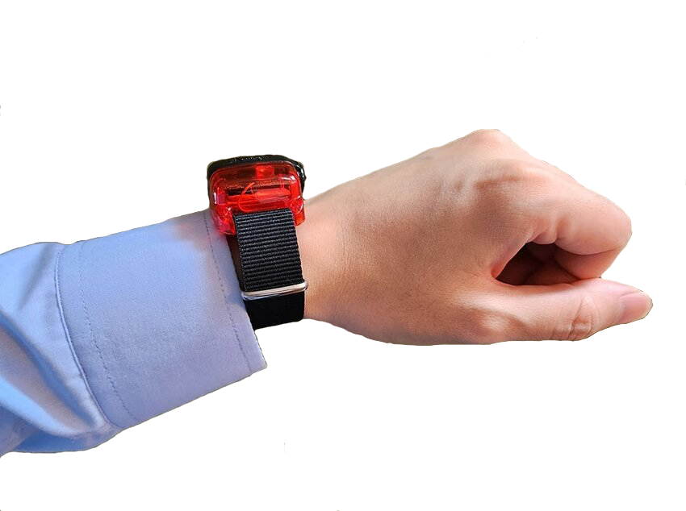
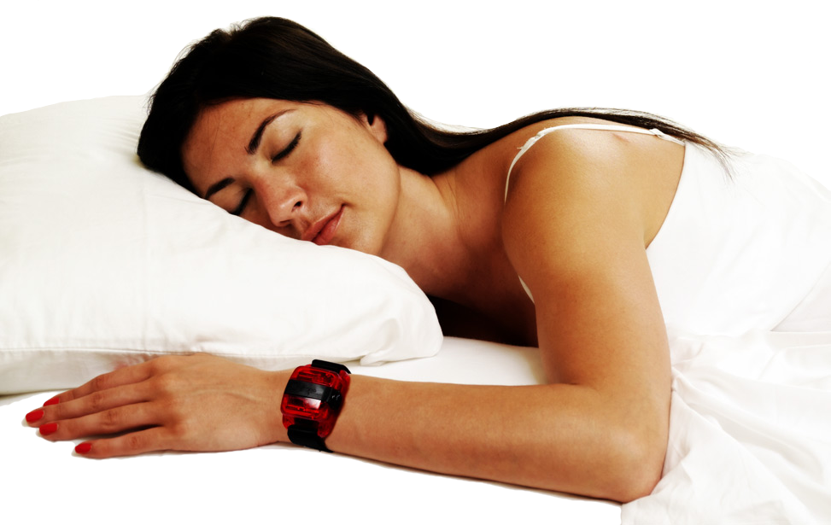

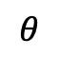
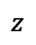
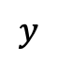
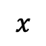
Continuous recording of accelerometer data for ~1000 subjects spanning many days.
$$z$$
$$x$$
$$θ$$
$$y$$
ENMO
5-minute bouts
The Data: Actigraphy
Thresholds
Notes:
Approximately 1000 participants [click]
were given a wrist-worn accelerometer [click]
Which reported acceleration in three dimensions [click]
And angle from horizontal. [click]
Unfortunately, some devices were set to record during sedentary activity and identify when they weren’t being worn, while others were set to just shut off during sedentary activity, [click]
so we had to design our methods to account for these instances [click]
We computed Euclidean Norm Minus One values [click]
Then grouped the data into 5-minute bouts to compute means [click]
We reviewed actigraphy research to identify thresholds and then computed daily rates above the thresholds for each participant. [click]

Slide 11
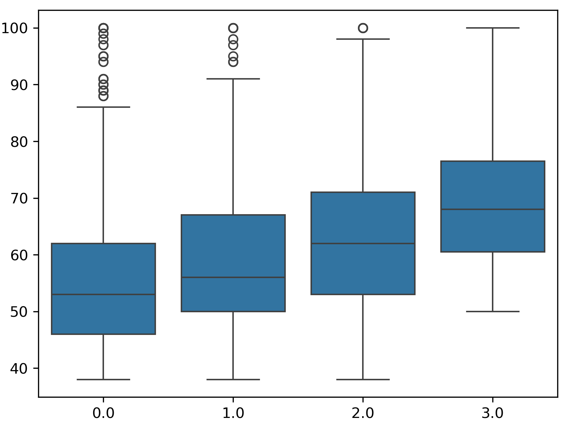
Missing data
Little predictive power
Predictor Variable
Outcome (SII)
Data Challenges
Notes:
In addition to [click]
the challenges of missing data described previously, we faced some important challenges intrinsic to the data itself. [click]
For each potential predictor variable we looked at [click]
When we compared values between levels of the outcome variable [click]
There was a considerable amount of variation and [click]
None of our variables demonstrated much predictive power [click]

Slide 12
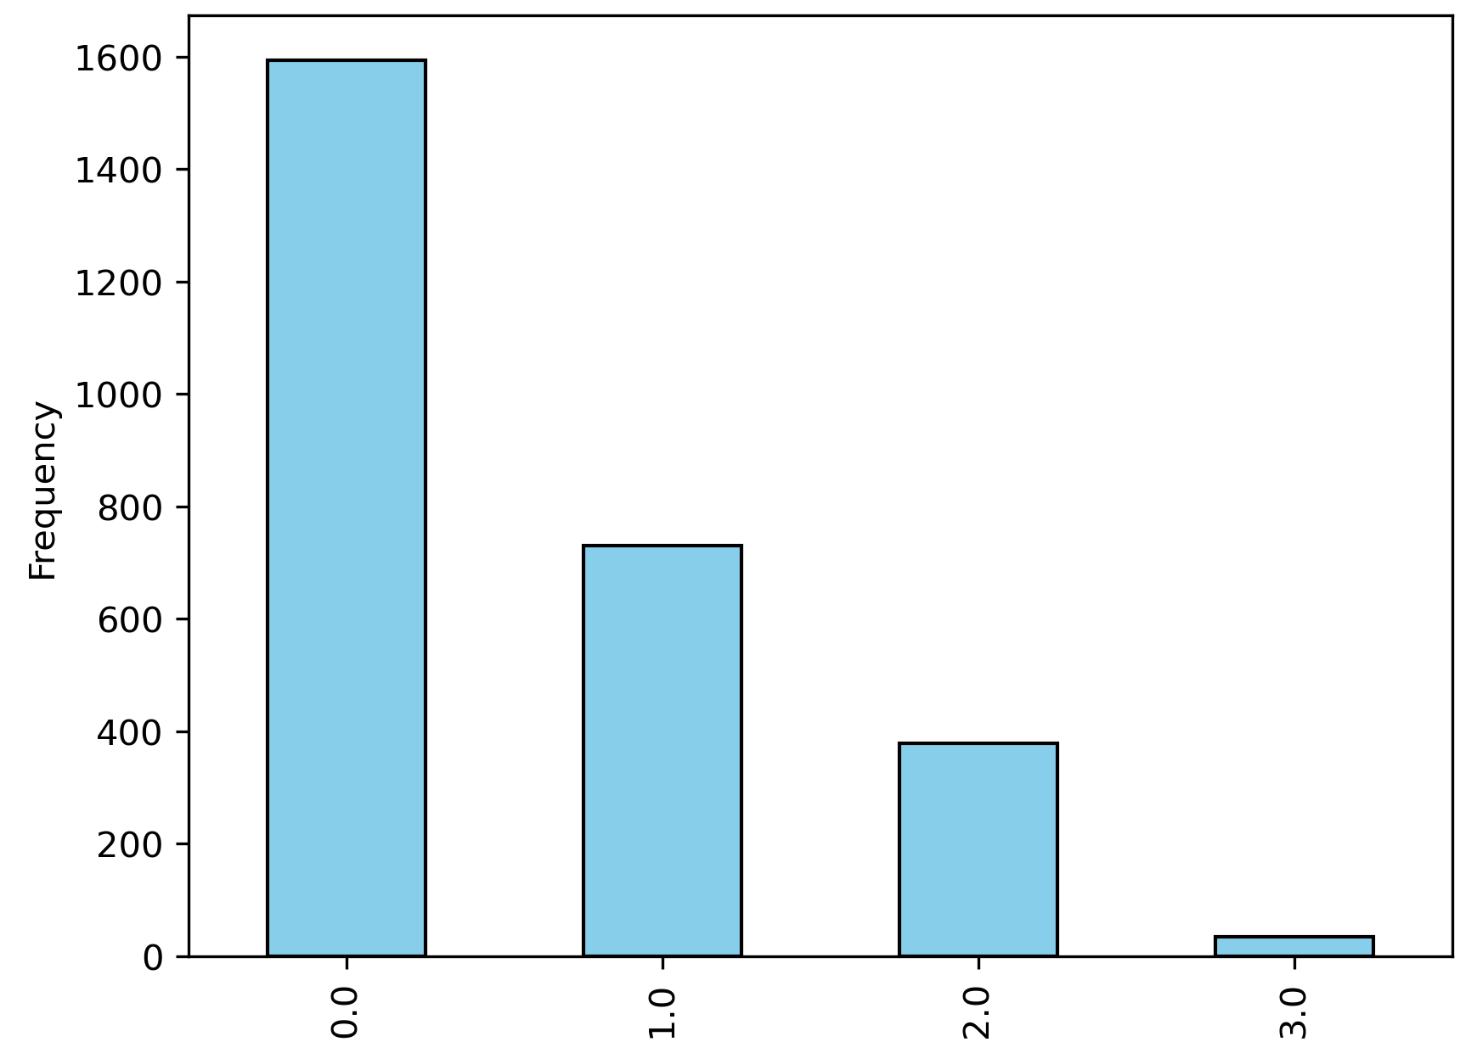
Missing data
Little predictive power
Sparse data for SII score 3.
Outcome (SII)
Data Challenges
Notes:
In addition, when we looked at [click]
the distribution of the values of our outcome variable, we found that [click]
there were only 32 participants who were measured with an SII score of 3; and a very high rate of 0’s. [click]
This sparse data meant that our models generally had a very hard time predicting higher levels of internet use [click]

Slide 13
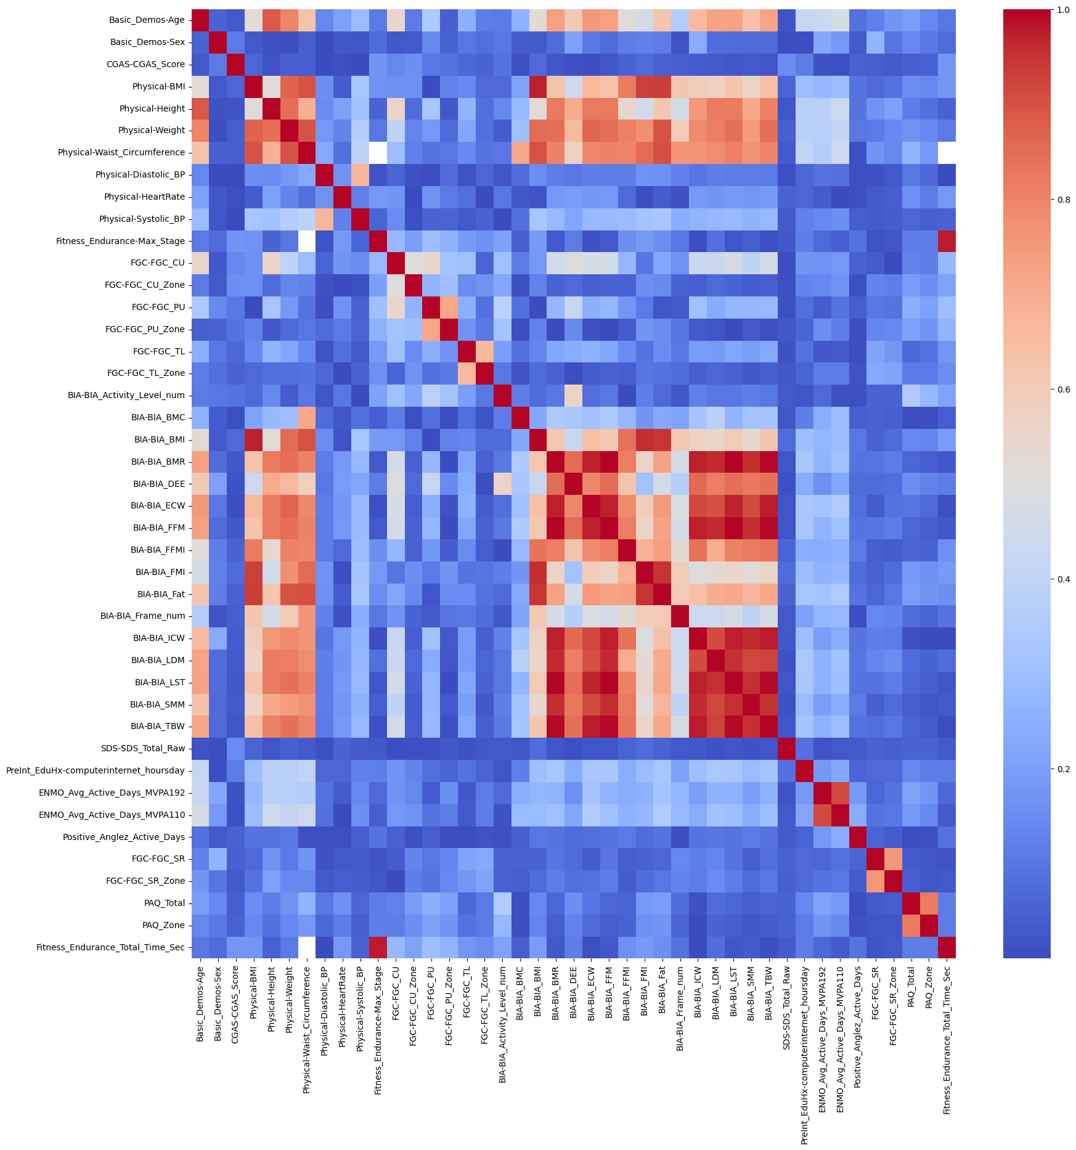
Missing data
Little predictive power
Sparse data for SII score 3.
Feature Reduction
Feature Selection
Data Challenges
Notes:
We also found that [click]
Many of our predictors were highly correlated And others were systematically missing [click]
So we engaged in several rounds of feature reduction [click]
And also identified important features using a random forest [click]

Slide 14
Cleaned, Computed, Outcome-Imputed, Feature-Selected Data
Custom Iterative Imputer
Custom Function Transformer
Sequential Ordinal Classifier Wrapper
Impute Predictors
Compute Predictors
SMOTE
sii=3
Fit & Predict
Kappa
SLR
MLR
Logistic
Random Forest SVR
AdaBoost
GradientBoost
XGBoost
+ Tuning
Modeling Process
Notes:
We began our modeling process [click]
With our cleaned, computed, outcome-imputed, and feature-selected data [click]
We designed an iterative imputer for missing predictor values [click]
A function transformer to compute zones for various predictors [click]
And an algorithm to sequentially apply classifiers to ordinal data [click]
In our pipe [click]
We first imputed and computed predictors [click]
Then we oversampled the sii=3 class using a Synthetic Minority Oversampling Technique [click]
Then made our predictions [click]
Using Cohen’s kappa as our measure of accuracy. [click]
We tested out-of-the-box performance with a range of models [click]
Then tuned the most promising models

Slide 15
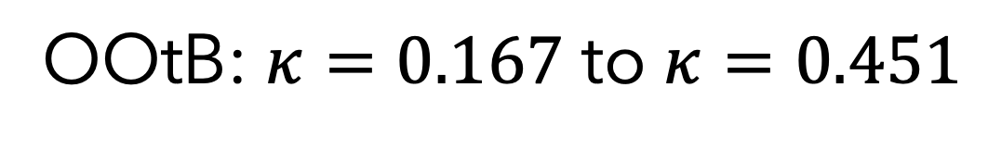
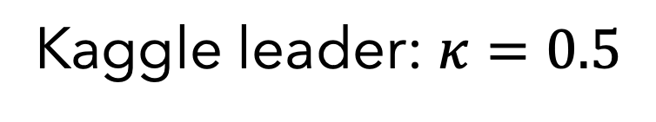
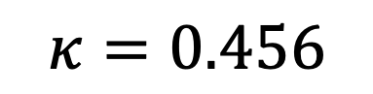
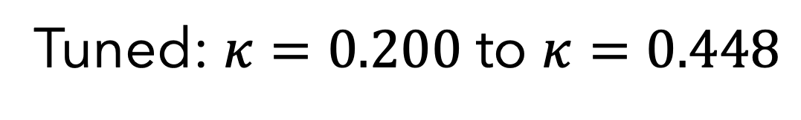
OOtB: $κ=0.167$ to $κ=0.451$
Tuned: $κ=0.200$ to $κ=0.448$
Final Model
Test Data
Tuned Gradient Boosting Regressor
PCIAT
SII
Custom-tuned bins
$$κ=0.456$$
Kaggle leader: $κ=0.5$
Final Results
Predicting problematic internet use is difficult
Notes:
In our initial exploration of [click]
out-of-the-box performance, we got kappa values between 0.167 and 0.451 [click]
After tuning models, we weren’t able to improve these values significantly on the train data [click]
For our final model we used a tuned gradient boosting regressor [click]
Which took our test data and used it to predict PCIAT values [click]
Then we used custom-tuned bins to compute SII values [click]
Which resulted in a kappa value of 0.456. Although this kappa value looks low, [click]
the current leader in the Kaggle competition—out of nearly 3,000 teams, many of which have hundreds of submitted models—only managed a kappa value of 0.5. Although there are certainly ways we could improve our model [click]
This suggests to us that predicting problematic internet use is difficult

